Slide 1
Life cycle of a Thread (Thread States)
A thread can be in one of the five states. According to sun, there is only 4 states in thread life cycle in java new, runnable, non-runnable and terminated. There is no running state.
But for better understanding the threads, we are explaining it in the 5 states.
The life cycle of the thread in java is controlled by JVM. Thread states are:
New
Runnable
Running
Non-Runnable (Blocked)
Terminated

Slide 2
New
The thread is in new state if you create an instance of Thread class but before the invocation of start() method.
Runnable
The thread is in runnable state after invocation of start() method, but the thread scheduler has not selected it to be the running thread.
Running
The thread is in running state if the thread scheduler has selected it.
Non-Runnable (Blocked)
This is the state when the thread is still alive, but is currently not eligible to run.
Terminated
A thread is in terminated or dead state when its run() method exits

Slide 3
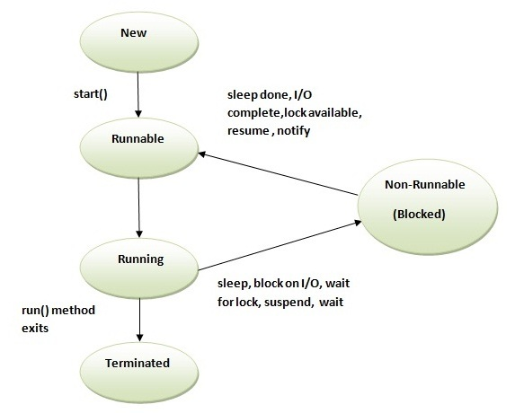

Slide 4
Sleep Method in Java
The sleep() method of Thread class is used to sleep a thread for the specified amount of time.
Syntax of sleep() method in java
The Thread class provides two methods for sleeping a thread:
public static void sleep(long miliseconds)throws InterruptedException
public static void sleep(long miliseconds, int nanos)throws InterruptedException

Slide 5
class TestSleepMethod1 extends Thread{
public void run(){
for(int i=1;i<5;i++){
try{
Thread.sleep(500);
}
catch(InterruptedException e)
{
System.out.println(e);
}
System.out.println(i);
}
}
public static void main(String args[]){
TestSleepMethod1 t1=new TestSleepMethod1(); TestSleepMethod1 t2=new TestSleepMethod1();
t1.start();
t2.start();
}
}

Slide 6
Output
1
1
2
2
3
3
4
4

Slide 7
Can we start a thread twice
No. After starting a thread, it can never be started again.
If you does so, an IllegalThreadStateException is thrown.
In such case, thread will run once but for second time, it will throw exception.

Slide 8
public class TestThreadTwice1 extends Thread
{
public void run()
{
System.out.println("running...");
}
public static void main(String args[])
{
TestThreadTwice1 t1=new TestThreadTwice1();
t1.start();
t1.start();
}
}
running
Exception in thread "main" java.lang.IllegalThreadStateException

Slide 9
The join() method
The join() method waits for a thread to die. In other words, it causes the currently running threads to stop executing until the thread it joins with completes its task.
class TestJoinMethod1 extends Thread{
public void run()
{
for(int i=1;i<=5;i++)
{
try{
Thread.sleep(500);
}
catch(Exception e)
{System.out.println(e);}
System.out.println(i);
}
}

Slide 10
public static void main(String args[]){
TestJoinMethod1 t1=new TestJoinMethod1();
TestJoinMethod1 t2=new TestJoinMethod1();
TestJoinMethod1 t3=new TestJoinMethod1();
t1.start();
try{
t1.join();
}catch(Exception e){System.out.println(e);}
t2.start();
t3.start();
}
}
Output:
1
2
3
4
5
1
1
2
2
3
3
4
4
5
5

